Slide 1

CMR COLLEGE OF ENGINEERING & TECHNOLOGY
Kandlakoya, Medchal, Hyderabad - 501401
Department of Computer Science and Engineering
HAND GESTURE VOLUME CONTROLLER
Batch No.:37
Name of the student:
Md.Moqeed(20H51A05A1)
P.Shiva Charan(20H51A05J1)
S.Neeraj Kumar(20H51A05J6)
Under esteemed guidance of
Guide Name
Ms.P.Sravanthi
(Assistant professor)

Slide 2
Outline
Abstract
Introduction
Research Objective
Problem Definition
Scope of the Project
Research work
- Proposed Methodologies
- System Architecture
- Comparison of Proposed system with an existed system
Results
Conclusion
Future Work
References
Notes:
2

Slide 3
Abstract
Notes:
3

Slide 4
ABSTRACT
There are several ways of communication for understanding the information and processing. For human interaction we use verbal and non verbal communication. Non verbal communication include sign language. Hand gesture is also one of the sign language. It has a wide area of application in human computer interaction and sign language. The intention of this project is to recognize the hand gesture moments and utilize those moments for human computer interaction. The main goal of gesture recognition is to create a system which can identify specific human gestures and use those detections by device for understanding , recognizing performing tasks on the information for human computer interaction.
In this project we are going to create a system which could be used to control the volume of a device by using simple hand gesture without using mouse or keyboard.

Slide 5
INTRODUCTION
Notes:
5

Slide 6
Introduction
Hand gestures are powerful and spontaneous powerful mode of communication which are useful for human computer interaction Several input devices are available for interaction with computer, such as keyboard, mouse, joystick as well as touch screen; however they are not advanced interface.
Here we proposed system which acts as a interface, through which hand gesture used as input tasks instead of input devices. Web camera is used capturing the hand image and tracking it. The hand gesture should be recognized for hand tracking and segmentation.
This is a Vision Based method which require only a camera for human computer interaction without the use of any extra devices. Here Computer Vision acts as an artificial vision source for the device for tracking the hand posture and gesture recognition which can be implemented with various algorithm software and/or hardware.
Notes:
6

Slide 7
Research Objective
Notes:
7

Slide 8
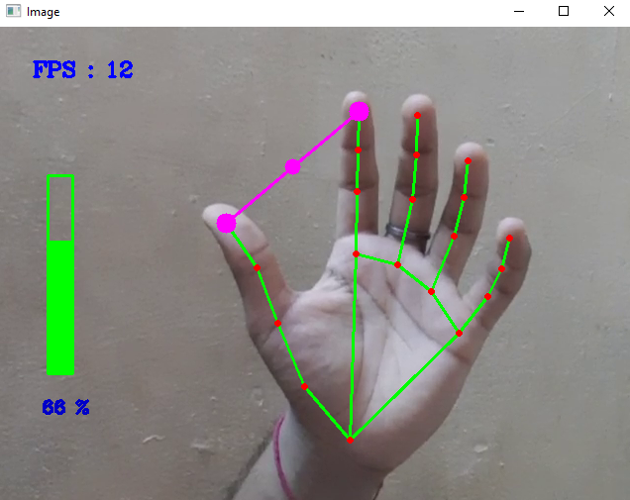
Research objective
The primary objective of hand gesture recognition is to develop a system that can recognize human hand gestures and use that information to control a device.
With real-time gesture recognition, a specific user can control a computer by making hand gestures in front of a system camera that is connected to a computer.

Slide 9
Problem Definition
Notes:
9

Slide 10
Problem Definition
Classical interactions tools like keyboard, mouse, touchscreen, etc. may limit the way we use the system. All these systems require physical contact, in order to interact with system. Gestures can interpret same functionality without physically interacting with the interfacing devices.
This system basically uses the web camera to record or capture the images /videos and accordingly on the basis of the input, the volume of the system is controlled by this application. The main function is to increase and decrease the volume of the system.

Slide 11
Scope of the Project
Notes:
11

Slide 12
Scope of the Project
Various hand gestures can be recognized and applied as input to the computer. The hand gestures representing numbers can also be converted into commands to perform related tasks in real time.
The robot can be used in a wheelchair that is controlled by the movements of the rider's hand. To access it from a larger distance, Wi-Fi can be utilized instead of Bluetooth for communication.

Slide 13
Research Work
Notes:
13

Slide 14
Proposed Methodologies
Detect hand landmarks.
Calculate the distance between thumb tip and index finger tip.
Map the distance of thumb tip and index finger tip with volume range.
In order to exit press 'Spacebar‘

Slide 15

System Architecture
CAPTURE
OBJECT DETECTION
HAND DETECTION
FEATURE EXTRACTION
GESTURE CONTROL
HAND

Slide 16
Comparison of Proposed system with an existed system
The hand gesture is the active area for the research in the vision community and the main purpose of the hand gesture is the sign language recognition and the human interaction. It is one of the original tracking systems for the hand motion. In this system a 27 degree freedom hand can be tracked at 10Hz by using the grayscale images and requires manual initialization step before beginning the tracking By the interaction perspective most of the hand tracking work by focusing on 20 interfaces.
Firstly a finger has been tracked by using the low cost web cameras in order to manipulate a traditional graphical interface without using keyboard and mouse. The Fingertip detection was done by fitting a conic to rounded features and local tracking of the tip.

Slide 17
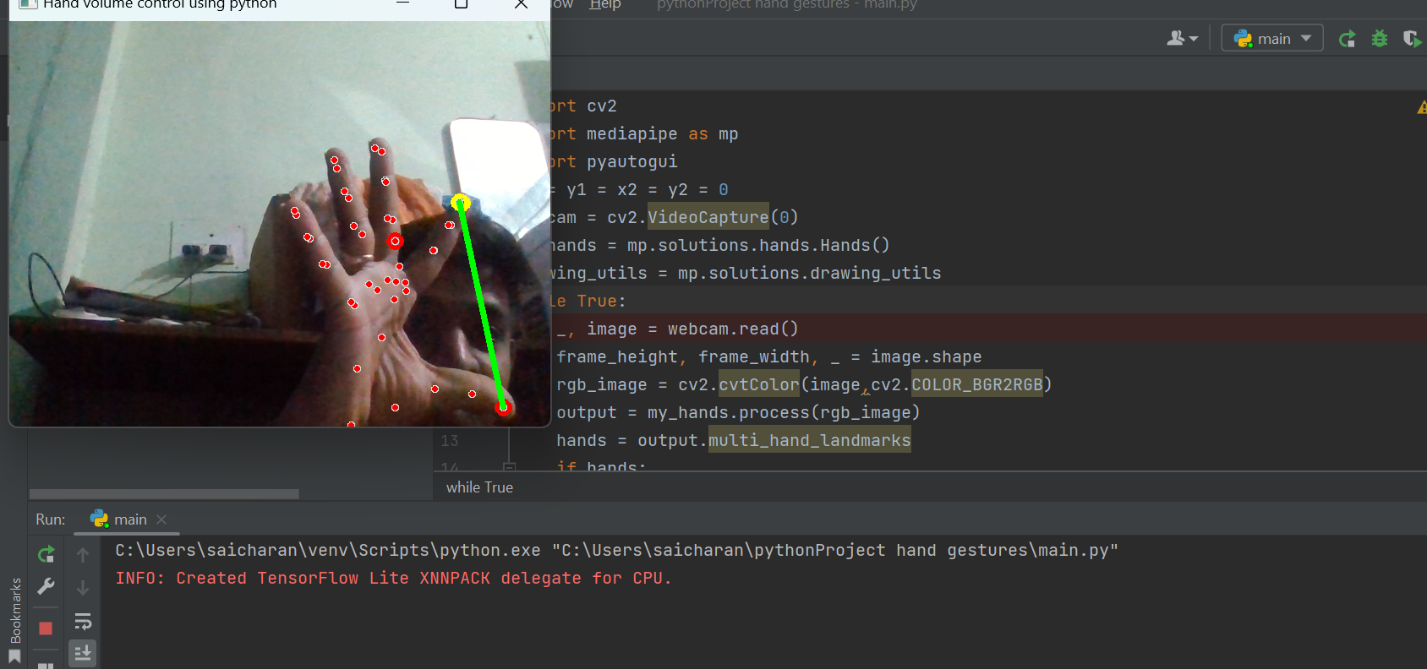
Result Analysis

Slide 18
Conclusion and Future Work
We developed a vision-based hand Gesture system that does not require any special markers/gloves as input devices and can operate in real-time using cameras. Here, the system can track the positions of the hand and index finger for each hand. The motivation for this hand Gesture was a desktop-based volume control system in which a user can control volume and cursor navigation in real time using natural hand motions. Besides, we propose to employ the motion of the mouse cursor controlled by the hand, and give a suggestion about how to, on the bare hand, position a point through which to control the movement of the mouse cursor.

Slide 19
References
1 GRS Murthy, R. S. Jadon (2009). "A Review of Vision Based Hand Gestures Recognition," International Journal of Information Technology and Knowledge Management, vol 2(2), pp. 405410 2. Z. Zhang, Y Wu, Y Shan, S. Shafer Visual panel: Virtual mouse keyboard and 3d controller with an ordinary piece of paper. In Proceedings of Perceptual User Interfaces, 2001
3 WT. Freeman and M. Roth, Orientation histograms for hand gesture recognition. International workshop on automatic
face and gesture recognition, 1995, 12: 296- 301

Slide 20
Thank You!

